Slide 1
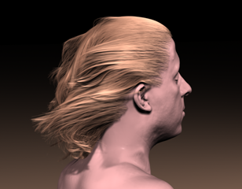
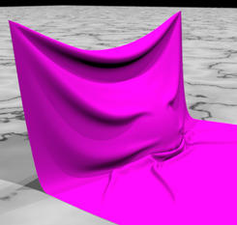
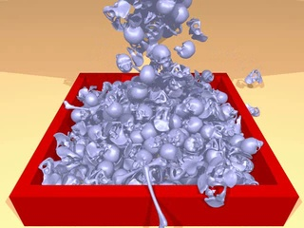
Chapter 5-4 Physically Based Simulation
Fluid Simulation

Slide 2
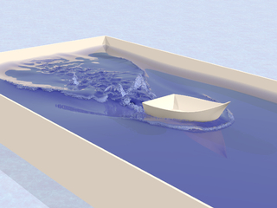
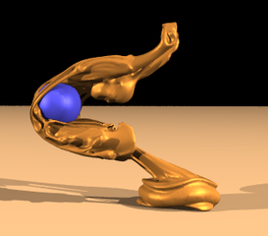
Content
Overview
Cloth Simulation
Particle System
Fluid Simulation
Hair Modeling & Simulation
Summary

Slide 3
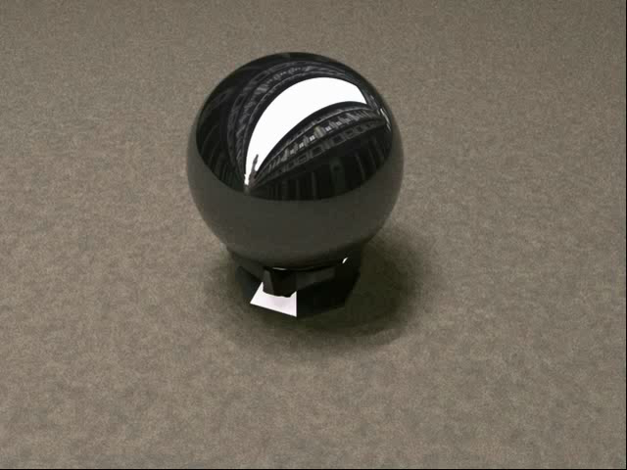
Demo

Slide 4
5.4.1 Fluid Behavior
Lots of molecules smack into each other over and over and over
Modeled as Continuum
Molecules way too tiny to simulate, even with the fastest computers
Break space into infinitesimal tidbits and do calculus
Constrained Physics
F=ma
Conservation of mass
Conservation of momentum
Notes:
Infinitesimal: 极其微小
Tidbit:小片，花边新闻
Smack: 拍打

Slide 5
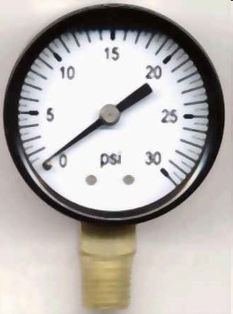
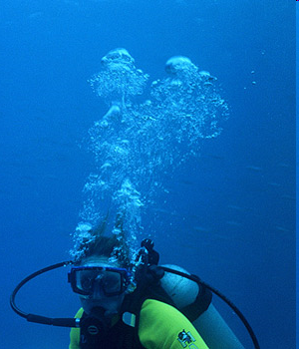
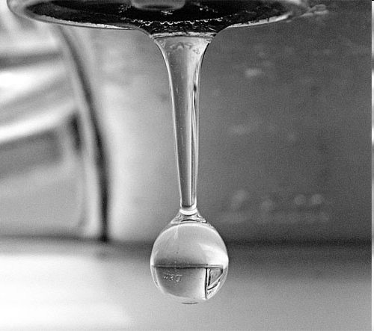
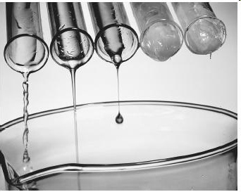
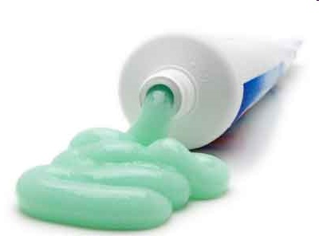
5.4.1 Fluid Behavior
What forces act on a fluid?
Gravity
Pressure
Viscosity
Collisions with Boundaries
Collisions with Other Objects
Surface Tension
Pressure from Other Fluids
Chemical Reactions
Elasticity
…

Slide 6
5.4.2 Reference Frames
Math depends on our coordinate system
Example: centrifugal force
Notes:
reference frame n. 坐标系统,参考系
Centrifugal：离心

Slide 7
5.4.2 Reference Frames
Math depends on our coordinate system
Example: centrifugal force

Slide 8
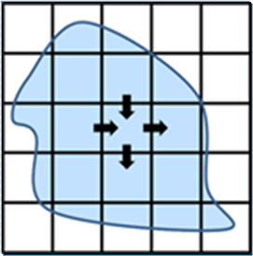
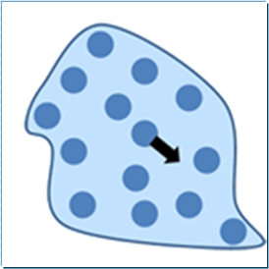
5.4.2 Reference Frames
Eulerian Framework
Earth’s point of view
Fluid moves, Earth stays fixed
Lagrangian Framework
Fluid’s point of view
Fluid locally stays fixed; Everything else moves
Notes:
对于流体的研究，有两种完全不同的视角，分别是欧拉视角和拉格朗日视角。
欧拉视角的坐标系是固定的，如同站在河边观察河水的流动一样，用这种视角分析流体需要建立网格单元，还会涉及到有限元等复杂的工程方法，一般用在离线的应用中。
拉格朗日视角则将流体视为流动的单元，例如将一片羽毛放入风中，那么羽毛的轨迹可以帮我们指示空气的流动规律。

Slide 9
5.4.3 Smoothed Particle Hydrodynamics
Lagrangian Framework
Model fluid as a particle system
Forces act on each particle
A Particle represents a sample of fluid
NOT individual molecules!

Slide 10
(1) SPH particles
SPH（Smoothed-Particle Hydrodynamics）:无网格方法
基本思想：将连续的流体（或固体）用相互作用的质点组来描述，各个质点组上承载各种物理量，包括质量、速度等，通过求解质点组的动力学方程和跟踪每个质点组的运动轨道，求得整个系统的力学行为
只要质点的数目足够多，就能精确地描述力学过程
Notes:
光滑粒子动力学sph(smoothed-particle hydrodynamics)

Slide 11
(1) SPH particles
SPH（Smoothed-Particle Hydrodynamics）
Position x
Velocity v
Mass m
… density?
… pressure?
… gradients?
… ???
Notes:
光滑粒子动力学sph(smoothed-particle hydrodynamics)

Slide 12
(2) Function Approximation
We want spatial derivatives（空间导数） (density, pressure, etc)
We can only take spatial derivatives of smooth functions
How do we turn infinitesimal point samples into a smooth function?
Mass samples
Density
x
x
Notes:
spatial derivative 空间导数,空间微商
Infinitesimal adj. 极微小的 adv. 无限小地

Slide 13
(3) Smoothing Kernel
Smooth out particle so that it occupies some space
Add all of these smoothed particles together to make a continuous function
Mass Samples
Density
x
Notes:
smoothing kernel 平滑核
“光滑核”的概念，可以这样理解这个概念，粒子的属性都会“扩散”到周围，并且随着距离的增加影响逐渐变小，这种随着距离而衰减的函数被称为“光滑核”函数，最大影响半径为“光滑核半径”。

Slide 14
(3) Smoothing Kernel
Smooth out particle so that it occupies some space
Add all of these smoothed particles together to make a continuous function
Mass Samples
Density
x

Slide 15
(3) Smoothing Kernel
Smooth out particle so that it occupies some space
Add all of these smoothed particles together to make a continuous function
Smoother kernel means smoother derivatives
Density
vs
x

Slide 16

(4) Smoothing Function
狄拉克δ函数(Dirac Delta function)
是一个广义函数，在物理学中常用其表示质点、点电荷等理想模型的密度分布，该函数在除了零以外的点取值都等于零，而其在整个定义域上的积分等于1
Notes:
狄拉克δ函数(Dirac Delta function)
是一个广义函数，在物理学中常用其表示质点、点电荷等理想模型的密度分布，该函数在除了零以外的点取值都等于零，而其在整个定义域上的积分等于1。

Slide 17
(4) Smoothing Function
The smoothing functions obey the following conditions
(1) the smoothing function should be normalized
(2)the smoothing function will become the Dirac delta function as h→0
Notes:
狄拉克δ函数(Dirac Delta function)
是一个广义函数，在物理学中常用其表示质点、点电荷等理想模型的密度分布，该函数在除了零以外的点取值都等于零，而其在整个定义域上的积分等于1。

Slide 18
(4) Smoothing Function
(3)The smoothing function should satisfy the compact condition
.
κ is a scale factor. (constant 2 or 3)
(4) the smoothing function should take the form
where α_{d} is the normalization constant, and

Slide 19
(4) Smoothing Function
Normalization
Compact
紧支性条件
Non-negative
Dirac delta function
Formulation
Monotonically decreasing
Even (symmetric) function
Sufficiently smooth
Notes:
(1) 归一性
(2) 满足紧支性条件（紧支域）
(3) 光滑函数是正的
(4) 当粒子间的距离增大时，粒子的光滑核函数值应该是单调递减的（衰减性）。
随着两个相互作用粒子间的距离增大，他们的相互作用力减小。
(5) 当光滑长度趋于0时，光滑核函数应该满足 Dirac delta function
(6) 光滑核函数应为偶函数（对称性质）
(7) 光滑核函数应充分光滑（光滑性）
对于一个函数及其导数的近似，光滑核函数必须充分连续以得到好的结果。通常，光滑核函数的值越光滑，所求函数及其导数的结果就越好。

Slide 20
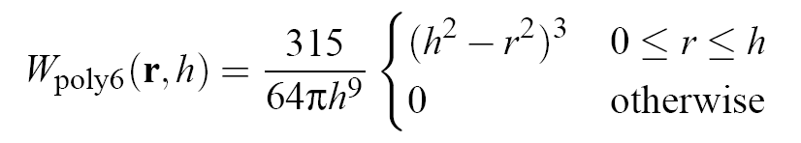
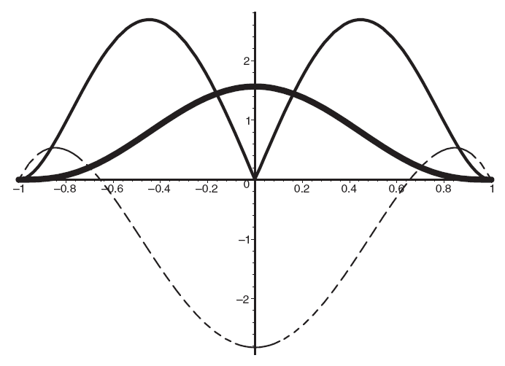
Example Smoothing Kernel
r = distance from particle,
h = kernel width
kernel
1st derivative
2nd derivative
Notes:
密度计算使用的光滑核函数称为Poly6函数
该核函数仅包含的平方项，在距离计算中不需计算平方根，因此节省了计算量。但若采用该核函数计算压力，会出现压力较大时，粒子集聚的现象。当r趋于0时，梯度也趋于0，因此当粒子接近时，排斥力会趋于消失，引起集聚现象。

Slide 21
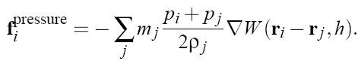
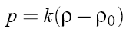
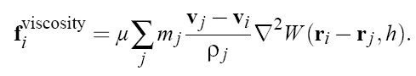
(5) SPH Forces
Pressure
Viscosity
Gravity
Collisions

Slide 22
(5) SPH Pros & Cons
Good
Long term conservation of mass
Conservation of momentum
Symmetric particle forces
Fast!!!
Unrestricted simulation domain
Bad
Can become unstable
Requires extra damping
Compressibility
Surface rendering needs improvement

Slide 23
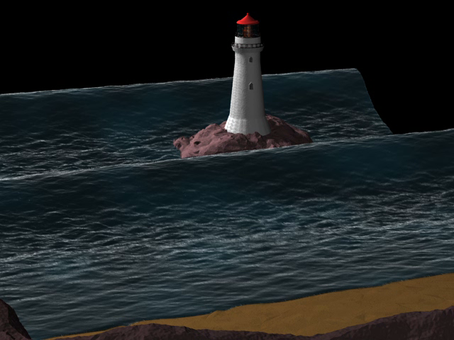
Demo

Slide 24
5.4.4 Navier-Stokes Equations
描述粘性不可压缩流体动量守恒的运动方程
是一组描述象液体和空气这样的流体物质的方程
这些方程建立了流体的粒子动量的改变率(加速度)和作用在液体内部的压力的变化和耗散粘滞力(类似于摩擦力)以及重力之间的关系
这些粘滞力产生于分子的相互作用，说明液体有多粘
纳维-斯托克斯方程描述作用于液体任意给定区域的力的动态平衡

Slide 25
5.4.4.1 Multivariate Calc Review
Gradient
Scalars or vectors
Divergence
Vectors only!
Laplacian
Scalars or vectors
Notes:
散度（divergence）可用于表征空间各点矢量场发散的强弱程度，物理上，散度的意义是场的有源性。
Laplacian 算子是n维欧几里德空间中的一个二阶微分算子，定义为梯度grad()的散度div()

Slide 26
5.4.4.1 Multivariate Calc Review
全微分

Slide 27
5.4.4.2 Force Equations
Gravity
Constant acceleration
Pressure
From high to low pressure
Viscosity
Friction averages out nearby velocities
Collision with Boundary
Flip velocity in normal direction, for example

Slide 28
5.4.4.3 Eulerian Fluid
Forces derived for a continuum
We don’t care about forces on a single point
We want forces per unit volume
Divide all equations by volume, to get density in place of mass
Notes:
Continuum：[数]连续统; [经]连续统一体; 闭联集; [物]连续区;

Slide 29
5.4.4.4 Navier-Stokes Equations
Derivation of momentum equation

Slide 30

5.4.4.4 Navier-Stokes Equations
Derivation of momentum equation
是流体密度；v是速度矢量；p是压力

Slide 31
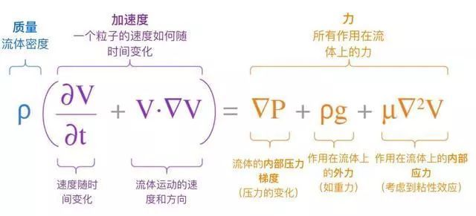
5.4.4.4 Navier-Stokes Equations
Notes:
流体（气体、液体）流动时，若流体中任何一点的压力，速度和密度等物理量都不随时间变化，则这种流动就称为定常流动，也可称之为“稳态流动”或者“恒定流动”；反之，只要压力，速度和密度中任意一个物理量随时间而变化，流体就是作非定常流动或者说流体作时变流动。

Slide 32
5.4.4.5 Incompressible Navier-Stokes Equations
We don’t care about supersonic flow
Subsonic flow is almost impossible to compress
Solids … Rigidity
Fluids … Incompressibility
Implemented as a constraint equation
Notes:
Supersonic:超声
Subsonic：亚音速
亚音速的流动，因为速度比音速低，所以空气压缩性影响较小，有时可以忽略。但是一般地说，即使在亚音速的范围里，当靠近音速时，空气压缩性的影响也会强烈地表现出来。

Slide 33
(1) Divergence
Total flux through a surface
Measure of compressibility
compressible
incompressible
incompressible
Notes:
Flux：流量

Slide 34
(2) Eulerian Grid
Break space up into tiny cubic cells
Store data at cell corners, for example

Slide 35
(3)Advection
Carries stuff through velocity field
E.g. smoke density, or velocity itself
Distance traveled
In one time step
Notes:
Advection：水平对流，移流
对流项

Slide 36
(4) Finite Differences有限差分
Approximate all derivatives
Use grid spacing to approximate infinitely small dx
dx
Notes:
finite difference 有限差，有限差分

Slide 37
(5) Operator Splitting
是一类偏微分方程数值解法，指把复杂的算子分裂成几个较简单的子算子之积而导出的数值解法
Notes:
operator splitting 算子分裂
是一类偏微分方程数值解法，指把复杂的算子分裂成几个较简单的子算子之积而导出的数值解法

Slide 38
(5) Operator Splitting
Only have to do one operation at a time!

Slide 39
(5) Operator Splitting
Only have to do one operation at a time!

Slide 40
(5) Operator Splitting
Only have to do one operation at a time!

Slide 41
(6) Pressure
After discretizing all derivatives with finite differences, We have two linear equations
Two equations with two unknowns
Pressure p
Future velocity v
Solve linear system
Done!
Repeat with new velocity in the next timestep
Pressure acts as a Lagrange Multiplier!
What is the constraint?
new

Slide 42
(7) Putting it All Together
Solve Navier-Stokes
Begin with original velocity

Slide 43
(7) Putting it All Together
Solve Navier-Stokes
Begin with original velocity
Advect

Slide 44
(7) Putting it All Together
Solve Navier-Stokes
Begin with original velocity
Advect
Add Forces
Solve for new velocity

Slide 45
(8) Finite Difference Fluid Pros & Cons
Good
Unconditionally stable!
Looks more realistic
Smooth surfaces
Bad
Slow!
Memory intensive
Real time fluid is too viscous
Can lose mass over time
Notes:
Viscous：黏性的

Slide 46
SPH Demos
Adams et al. “Adaptively Sampled Particle Fluids”
Muller et al. “Particle-Based Fluid Simulation for Interactive Applications”
Becker et al. “Weakly compressible SPH for free surface flows”

Slide 47
Eulerian Fluid Demos
Jos Stam - Stable Fluids
Georgia Tech fluids
Rigid Fluid
Water Drops on Surfaces
Stanford fluids
Wrinkled flames and cellular patterns
Vortex particle method for smoke, water, and explosions
Two-way coupled SPH and particle level set fluid simulation
Other notable fluid animations
Wavelet Turbulence for Fluid Simulation
Liquid Simulation on Lattice-Based Tetrahedral Meshes

Slide 48

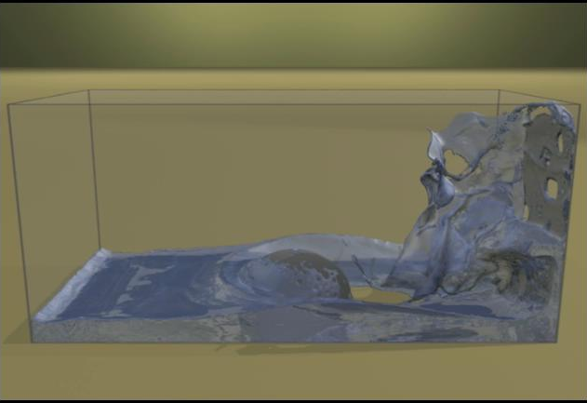
Demo

